Slide 1


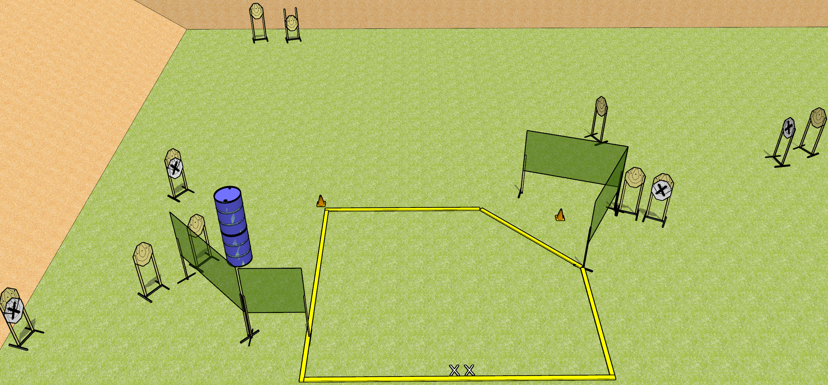
 | Dothan Gun Club – USPSA Match The Sickness Course Designer : Drew Coleman
START POSITION : Standing with both feet on X’s, wrists below belt
GUN READY CONDITION : Pistol loaded and holstered. PCC loaded, shouldered, safety on, pointed at either orange cone. |  | SCORING: Comstock, 20 rounds TARGETS: 10 paper, 0 Steel SCORED HITS: Best 2 on paper, steel until down START-STOP: Audible, last shot RULES:
STAGE PROCEDURE: Engage targets as they become available from within the fault lines.

Slide 2
The Sickness
Written Stage Briefing
The Sickness is a 20 round, 100 point, Comstock Medium Course. There are ten IPSC targets. The best two hits on paper will score. The start signal is audible.
Handgun start position is standing with both feet on X’s, inside the shooting area, wrists below belt. Handgun is loaded and holstered.
PCC start position is standing with both feet on X’s, inside the shooting area. Loaded carbine is held with both hands, safety on, pointed at either orange cone.
Upon start signal, engage targets as they become available from within the fault lines.

Slide 3
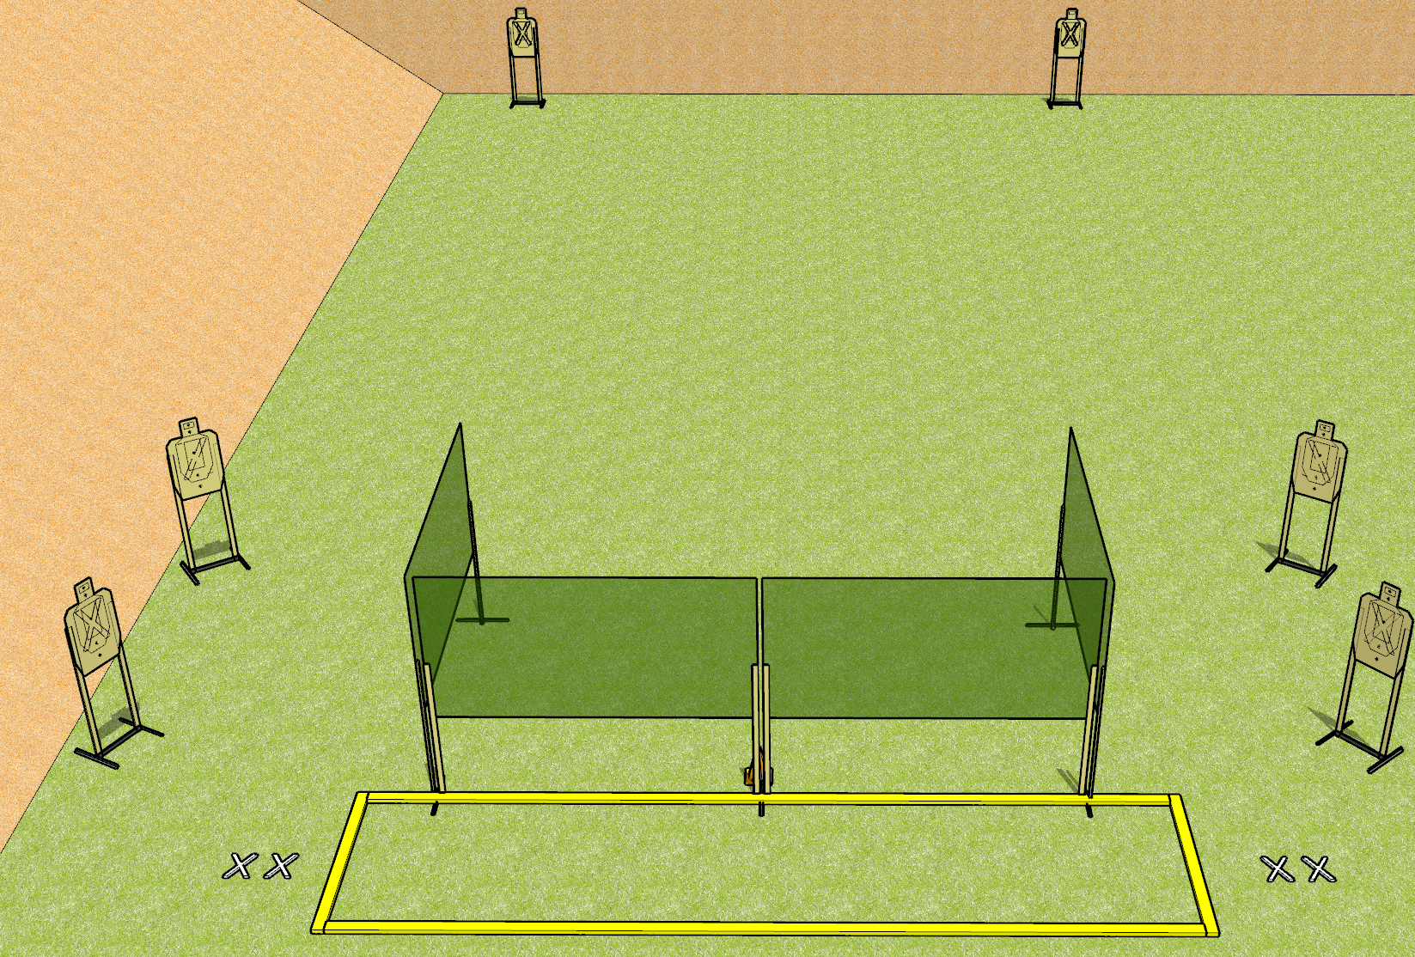
 | Dothan Gun Club – USPSA Match Bring Me Your Hate Course Designer : Drew Coleman
START POSITION : String 1: Standing with both feet on either set of X’s, wrists below belt. String 2: Standing with both feet on opposite set of X’s from string 1, wrists below belt.
GUN READY CONDITION : Pistol loaded and holstered. PCC loaded, shouldered, safety on, pointed at orange cone. |  | SCORING: Virginia Count, 12 rounds TARGETS: 6 paper, 0 Steel SCORED HITS: Best 4 on paper, steel until down START-STOP: Audible, last shot RULES:
STAGE PROCEDURE: String 1: Engage T1-T3 OR T4-T6 with only two rounds each, perform a mandatory reload, then engage remaining array with only two rounds each. String 2: Engage T1-T3 OR T4-T6 with only two rounds each, perform a mandatory reload, then engage remaining array with only two rounds each strong hand only.
T3
T4
T2
T5
T1
T6

Slide 4
Bring Me Your Hate
Written Stage Briefing
Bring Me Your Hate is a 24 round, 120 point, Virginia Count Standard Exercise. There are six USPSA targets. The best four hits on paper will score. The start signal is audible. There are two strings of fire.
Handgun start position for string one is standing with both feet on either set of X’s with pistol loaded and holstered, wrists below belt. The start position for string two is standing with both feet on the opposite set of X’s with pistol loaded and holstered, wrists below belt.
PCC start position for string one is standing with both feet on either set of X’s with loaded carbine held with both hands, safety on, shouldered, pointed at either orange cone. The start position for string two is standing on the opposite set of X’s with loaded carbine held with both hands, safety on, shouldered, pointed at either orange cone.
Targets are designated T1 through T6, from left to right per the stage diagram. Stage procedure for string one is to engage T1-T3 OR T4-T6 from within the shooting area with only two rounds each, perform a mandatory reload, then engage the remaining array with only two rounds each. Stage procedure for string two is to engage T1-T3 OR T4-T6 from within the shooting area with only two rounds each, perform a mandatory reload, then engage the remaining array with only two rounds each strong hand only.

Slide 5
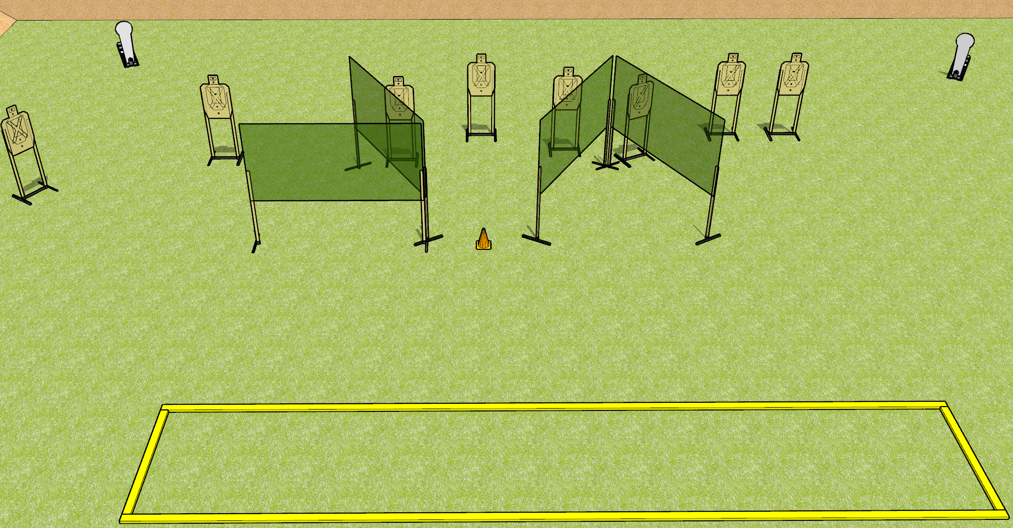
 | Dothan Gun Club – USPSA Match Something Borrowed Course Designer : Drew Coleman
START POSITION : Standing with both feet outside the shooting area, wrists below belt
GUN READY CONDITION : Pistol loaded and holstered. PCC loaded, shouldered, safety on, pointed at orange cone. |  | SCORING: Comstock, 26 rounds TARGETS: 8 paper, 2 Steel SCORED HITS: Best 3 on paper, steel until down START-STOP: Audible, last shot RULES:
STAGE PROCEDURE: Engage targets as they become available from within the fault lines.

Slide 6
Something Borrowed
Written Stage Briefing
Something Borrowed is a 26 round, 130 point, Comstock Long Course. There are eight USPSA targets and two Colt Poppers. The best three hits per paper target will score and steel must fall to score. The start signal is audible.
Handgun start position is standing with both feet outside of the shooting area, wrists below belt. Handgun is loaded and holstered.
PCC start position is standing with both feet outside the shooting area. Loaded carbine is held with both hands, safety on, shouldered, pointed at orange cone.
Upon start signal, engage targets as they become available from within the shooting area.
Admin note: yes I did steal this from nationals.

Slide 7
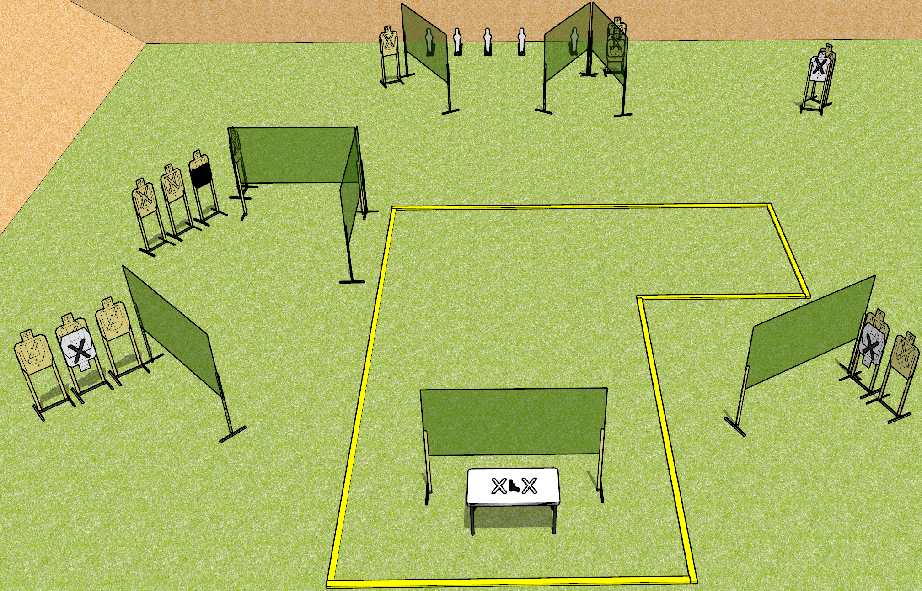
 | Dothan Gun Club – USPSA Match Horsing Around Course Designer : Drew Coleman
START POSITION : Standing with both hands palms flat covering X’s on table.
GUN READY CONDITION : Firearm loaded, safety on, pointed squarely down range, trigger guard on mark. |  | SCORING: Comstock, 31 rounds TARGETS: 13 paper, 5 Steel SCORED HITS: Best 2 on paper, steel until down START-STOP: Audible, last shot RULES:
STAGE PROCEDURE: Engage targets as they become available from within the fault lines.

Slide 8
Horsing Around
Written Stage Briefing
Horsing Around is a 31 round, 155 point, Comstock Long Course. There are thirteen USPSA targets and five mini-poppers. The best two hits on paper will score and steel must fall to score. The start signal is audible.
Handgun start position is with both hands covering marks with palms. Handgun is loaded, lying unsupported on table, with trigger guard on mark. Muzzle must be pointed squarely down range.
Handgun start position is with both hands covering marks with palms. Carbine is loaded, safety on, lying unsupported on table, with trigger guard on mark. Muzzle must be pointed squarely down range.
Upon start signal, engage targets as they become available from within the fault lines.

